Slide 1
Web Application Architectures
Web Programming
Spring 2023
Yaghoub Alizadeh
CE Department, Amirkabir University of Technology

Slide 2
Outline
MVC & MVVM Design Patterns
Multilayer Design
Microservices Architecture

Slide 3
Outline
MVC & MVVM Design Patterns
Multilayer Design
Microservices Architecture

Slide 4
Web Application Development
(Large) Applications cannot be developed in ad-hoc manner
We need design & architecture (SW engineering)
Concept separation, Component, Relations, …
There are so many architectural patterns
ETL, MFT, EAI, TDS, …
http://en.wikipedia.org/wiki/Architectural_pattern
Common architectures in web applications
MVC, MVVM, …
Multi-layer (Multi-tier), Microservices, …
Notes:
EAI:Enterprise application integration
ETL (data extraction transformation and loading)
MFT : Managed file transfer
TDS: Transaction data stores
MVVM: Model-View-ViewModel

Slide 5
MVC: Model-View-Controller
Model
Does all the computational work
It contains data and performs computation on it
View (the user interface)
Show the results from model or controller
Controller (of states sequences)
Handles events/requests affecting model or view
User inputs/requests go to the controller
Available commands are determined by controller (based on model)
Tells the model what to do
Notes:
In calculator: Using the memory as an example help to understand the Model

Slide 6
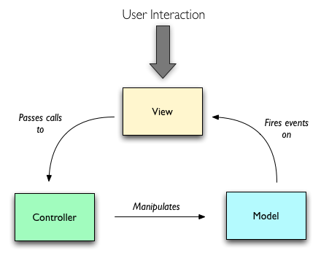

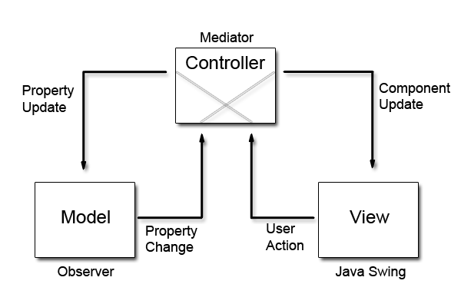
MVC Interactions?!

Slide 7
MVC Interactions (cont’d)
model
view queries model
controller updates model
model signals changes
view
controller
controller updates view
event
event is passed to the controller

Slide 8
MVVM Design Pattern
What is the role of the controller in MVC?
Basically updates V by changes in M and vice versa
Instead of coding the C, make it automated
Automatically update M by changes in V
Automatically update V by changes in M
Two-way binding
The Model-View-ViewModel pattern
The view model is a value converter^{[1]}
Responsible for exposing (converting) the data objects from the model in such a way that objects are easily managed and presented.

Slide 9
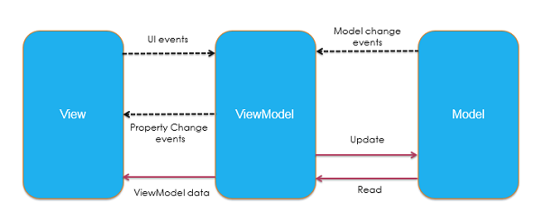
MVVM

Slide 10
The Patterns in Web Applications
Example: MVC for whole (client + server)
Model
Database tables (persistent data)
Session information (current stat data)
Server-side processing
View
(X)HTML
CSS
Controller
Client-side scripting
Part of processing by server side scripting

Slide 11
Outline
MVC Design Pattern
Multilayer Design
Microservices Architecture

Slide 12
Layering Approach
Common layering in web applications
Presentation Layer
Business logic Layer
Data (management/resource) Layer
These layers are purely abstractions
Not correspond to physical distribution
All layers may or may not be on the same machine
Physical layering is referred as multi-tier architecture

Slide 13
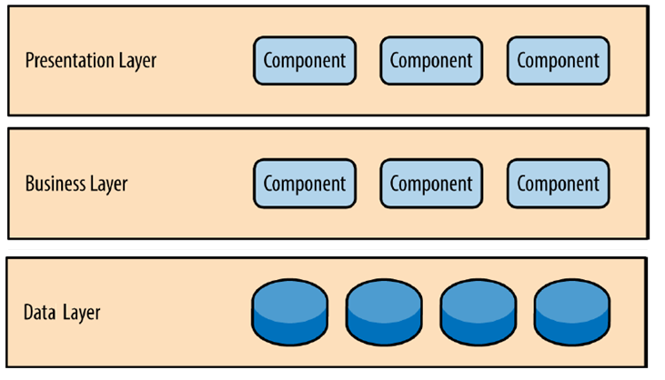
Multilayer Architecture

Slide 14
Presentation Layer
User interface of the application
GUI
HTML based browser
Displays information (processing output) which are get from the business logic layer
Gets user’s requests and pass them (with required data) to the business logic layer
Note that the user interface of web applications can be made up client side & server side codes
What is this layer in Gmail?

Slide 15
Business Logic Layer
The work that the application needs to do
Processing/Computing/Calculations
Receives requests from presentation layer
Fetches required data from data layer
Process the request & data
Output is sent back to the presentation layer

Slide 16
Data Layer
Provides data access interface to business logic
Hide data storage details
Hide heterogeneity of underlining systems
Communicating with data store systems
Database server
Messaging system
…

Slide 17
Traditional Multi-layer Web App
Server-Side Rendering
Presentation Layer
Client Side
(Browser)
Server Side
Presentation + Business Layer
PHP
Data Layer
DB
HTML + CSS + JS + JSON + XML + …

Slide 18
Modern Multi-layer Web App
Client-Side Rendering
Presentation Layer
Client Side
(Browser)
Server Side
Business Layer + Presentation Layer
Data Layer
DB
C
V
M
C
V
M
Ajax, fetch, …
HTML + CSS + JS + JSON + XML + …

Slide 19
Design Pattern in Modern Apps
Apply the design pattern in client side and server side separately!!!!
Client side frameworks
Angular 1.x: MVC
Angular 2.x: MVVM
React: MVC
Vue: MVVM
Server side frameworks
Laravel: MVC + MVVM

Slide 20
Multi-layer Architecture Issues
Scalability!!!
Business logic is monolithic
Tightly coupled modules
How to scale it?
Fault tolerance
If a part of business logic is failed → ???
Upgrade
How to upgrade a modules of business logic?

Slide 21
Outline
MVC Design Pattern
Multilayer Design
Microservices Architecture

Slide 22
Micro-Service Idea
Complex process can be divided into multiple loosely-coupled components
Each component
Is autonomous
Provides well-defined services
Via Remote API call
Distributed application
Easy to scale
Different technologies can be used

Slide 23
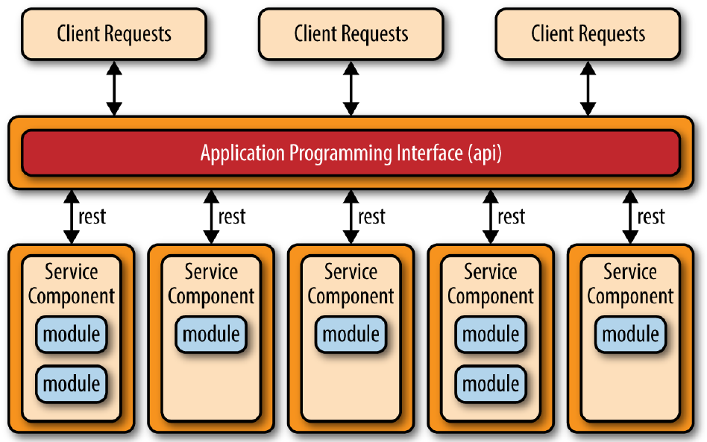
Microservices Architecture

Slide 24
Microservices for Modern Web App
Server Side
Service-1
Presentation Layer
Client Side
(Browser)
Service-0
DB Service
C
V
M
Service-n
Service-2
Ajax, fetch, REST, …
HTML + CSS + JS + JSON + …

Slide 25
References
MVC Wiki page
MVVM Wiki page
Multi-Layer/Multi-Tier Wiki page
Microservices Wiki page

